Slide 1
User Growth Hacking
Strategy
Consultant & Presenter: Shuvam

Slide 2
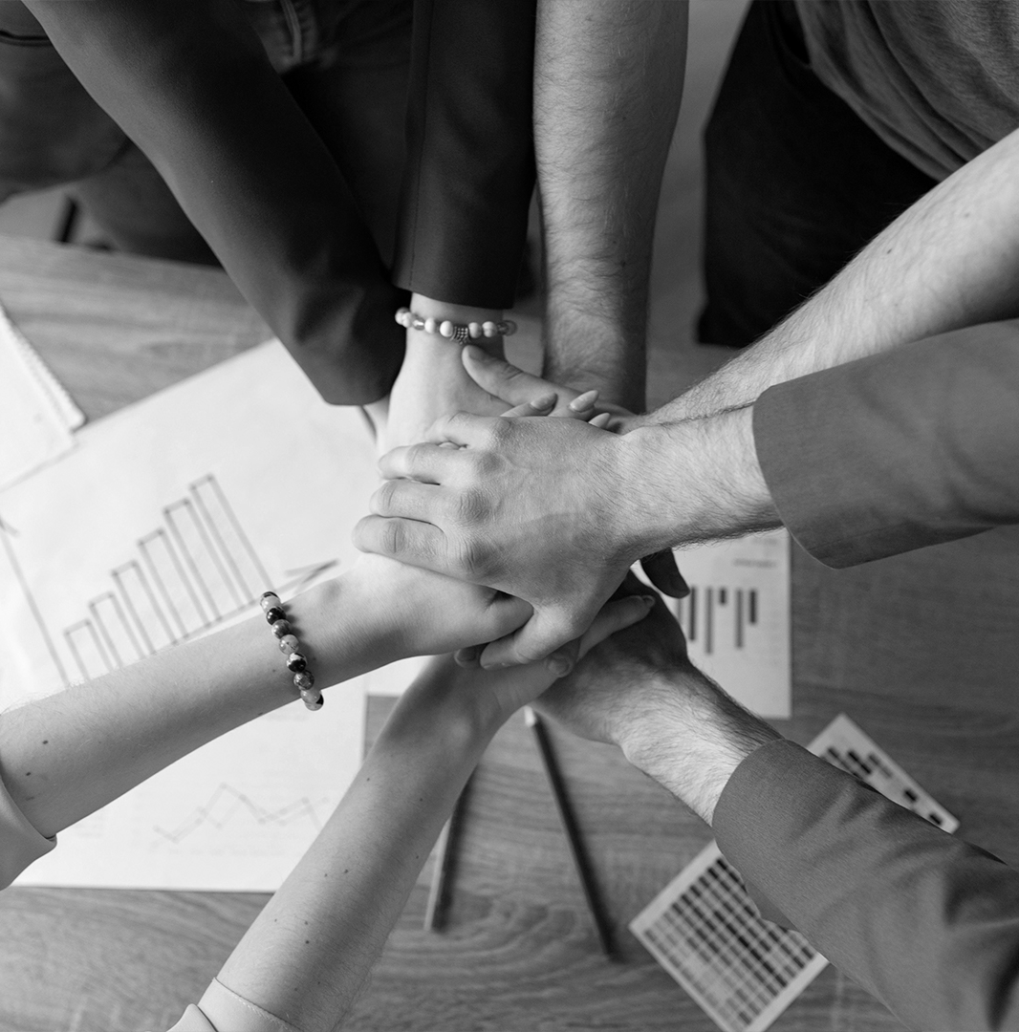
What is the goal of this strategy ?
The goal of this strategy is to hack user growth in the singapore region, this strategy is directed towards web2 users.

Slide 3
4 main steps into the growth hacking process following a lean marketing model
Acquisition
Retention
1
2
3
4
Activation
Referral

Slide 4
01
Acquisition
Getting new users to find out about ethlas

Slide 5
Analog Marketing Strategies
How can we market Ethlas to Web2 users offline?
Attempt to add / build games with an educational value, this can be used to market ethlas to educational institutions where it can be promoted to high school and university level students in singapore.
This method can take up a lot of effort and costs to implement, time to implement would also increase.
However, there is great long term benefit as Ethlas will be able to reach consumers both Online and offline, and allows us to directly engage and promote ethlas to a subsection of the target audience.
2. Ambassadors in high schools to encourage more users to try Ethlas
This is a less costly approach, and allows an increase in users in the short term, creating a referral cycle between students.
This method requires time due to a lack of available members at ethlas, ethlas team would have to approach a number of individuals to be nominated as ambassadors..

Slide 6
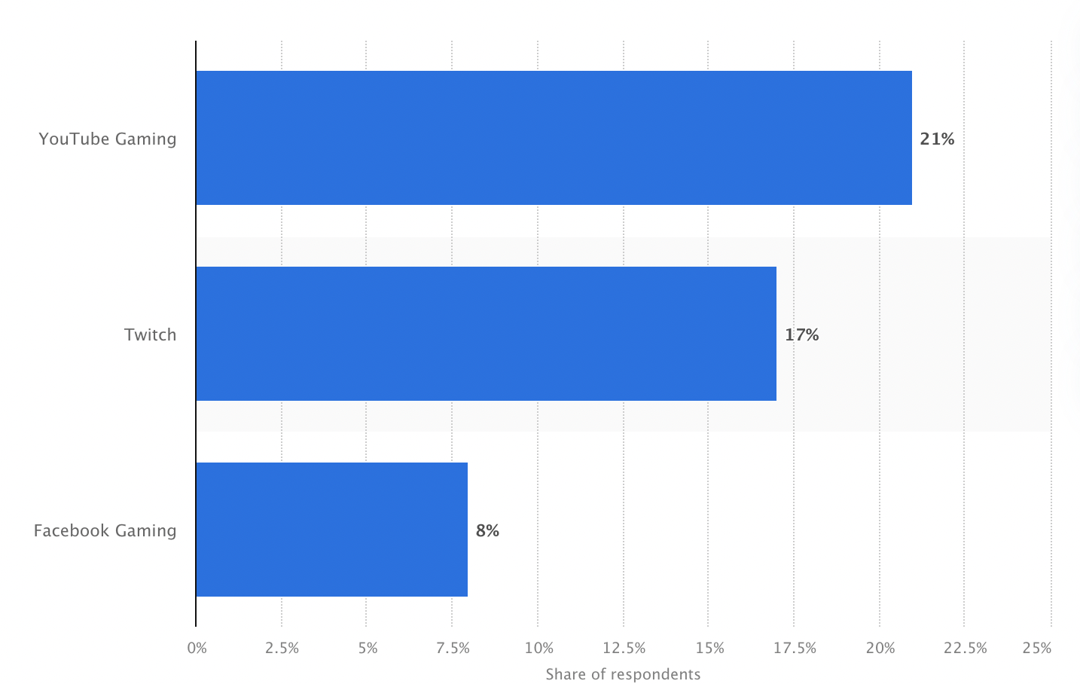
Promoting Ethlas on video streaming platforms
Promotion Level:
When comparing techniques to engage audiences to ethlas, Video platforms for live streaming or video sharing have higher customer retention, as well as exposure growth.
When aiming at gamers in singapore who are engaged actively using live streaming platforms, we can conclude that youtube gaming has the highest viewership out of the three, focusing on ethlas content creation on youtube gaming will be the most effective method to allow ethlas to go viral.
Source: Leading streaming sites used among gamers in Singapore as of September 2020, by platform

Slide 7
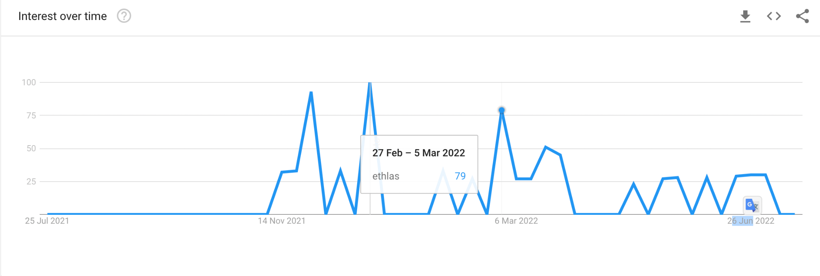
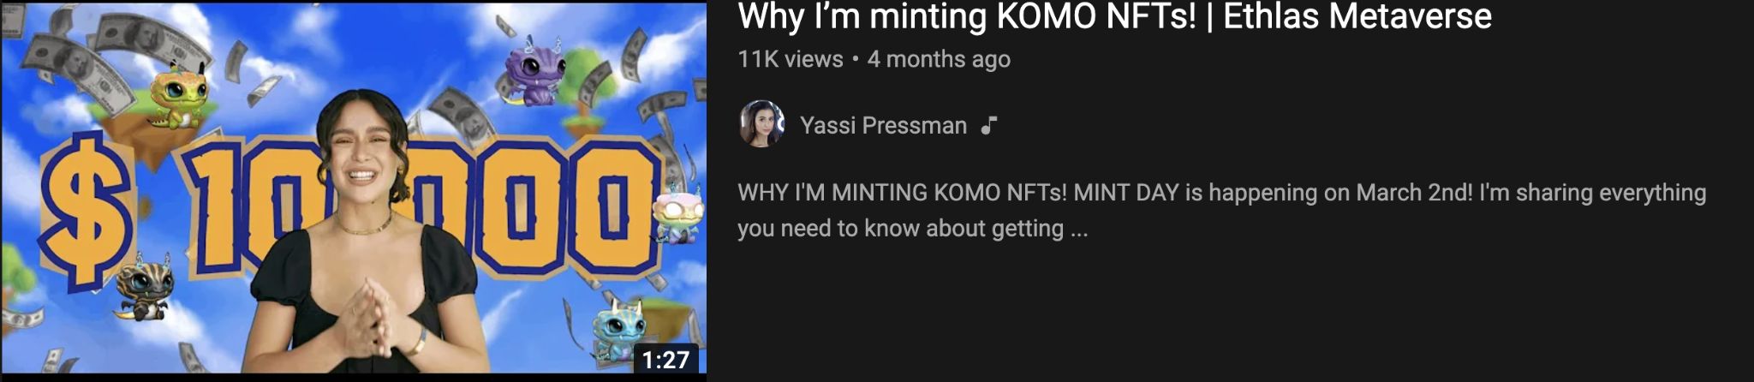
Influencer marketing
Promotion Level:
‘Ethlas’ topic search was at its recent peak since launch during the first week of March.
One cause of this was successful influencer marketing when youtuber Yassi pressman released a video detailing her profits and experience on ethlas, which garnered over 11,000 views
Video link: https://www.youtube.com/watch?v=KX92fcw5zrg
Source: https://trends.google.com/trends/explore?q=ethlas&geo=US

Slide 8
Influencer marketing
Promotion Level:
Through free to use metric softwares, we can identify key influencers and their competition, for example socialblade allows me to find the top influencers in singapore, https://socialblade.com/youtube/top/country/sg
We can order this by viewership count and identify gaming related youtube channels who are competing for viewership with previous sponsors such as yassi pressman, who require the new content and allows us to reach a separate fanbase and cause new gamers to find out about ethlas, even causing a similar spike in searches for ethlas and an influx of new members.
Some channels I have found Include;
https://www.youtube.com/c/jordentan/videos
https://www.youtube.com/c/ChunWeng
https://www.youtube.com/channel/UCM8T9z4vSYdEv2zW2mm6MkQ
They discuss similar topics, (Crypto enthusiast, NFT gamer/collector ) and are based in or around singapore and their subscriber base follows the trend on previous influencers sponsored by ethlas.

Slide 9
WEB2 Communities and pages to aim for:
Discord (communities where new users into the web3, crypto architecture can learn about the ethlas project firsthand and ethlas can gain an influx of new users) | Telegram (promoting the ethlas communities to groups with a large influx of beginners to crypto and the blockchain, such that they can learn about ethlas at initial stages)
Crypto collage - It’s a community for Web3 and NFTs enthusiasts seeking to learn new frameworks and study DAOs dynamics. Inside, you will find support, and training on designing tokenized communities
FWB ( friends with benefits) - There are over 14 thousand members who want to know about art projects that are taking place. Besides, it’s a great server to find mentorship and discussions related to DAOs, NFTs, WEB2 & Web3 in general.
Finflow - Is a well-known server with over 1,300 users interested in having an NFT space to discuss entrepreneurship. In addition to this, the server has spaces for beginners to ask questions and work together on exciting projects.
Bityard & DeCenter- interested individuals can subscribe to enjoy unlimited access to cryptocurrency information while leveraging the platform to connect with other crypto traders/enthusiasts.
Minter network- more than 300,000 members, and many traders join to get free information regarding upcoming tokens.
Altchica - With more than 7,200 members and still counting, Altchica boasts one of the largest communities of traders and investors

Slide 10
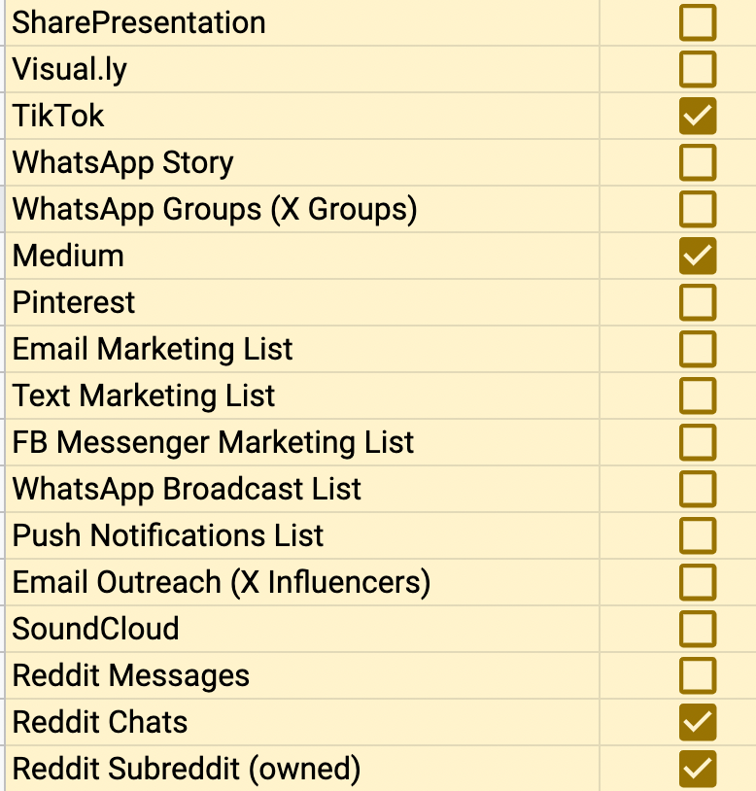
Diversifying social sharing to gain momentum: what other communities and areas can ethlas be promoted.
Possible Social sharing platforms
The linked spreadsheet contains possible social media spaces where Ethlas should be promoted (by increasing social sharing) excluding social media services which have already beenb targeted.
https://gamefaqs.gamespot.com/

Slide 11
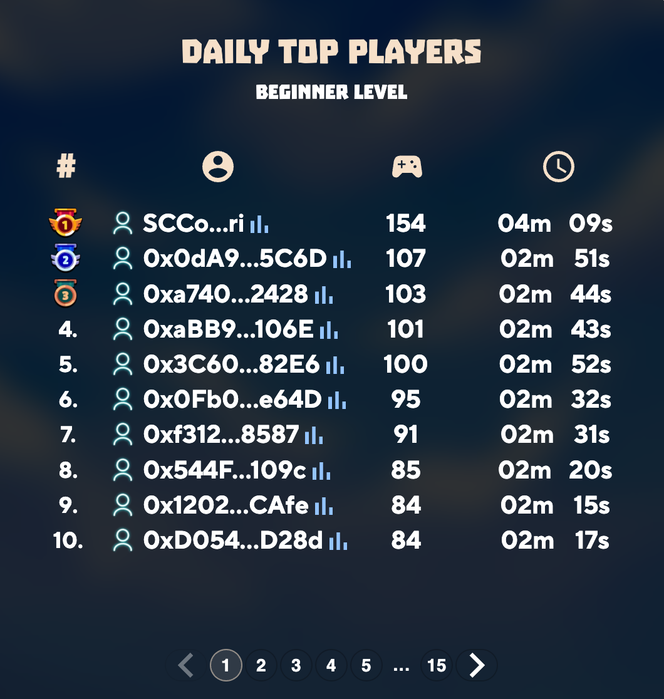
Using Existing users and Ingame features to boost popularity of ethlas on social media platforms
Notifying users of their Daily Top Ranking and providing an option to create a facebook post or posts to other communities to share their ranking.
The Post can have links which lead back to the ethlas landing page, again encouraging players to sign up and try ethlas for themselves.

Slide 12
02
Activation
Providing the best possible first time experience

Slide 13
Customer Experience Optimisation
Customer enters and logs in / signs up
Email nurture campaign
E-mail with tips and tricks on getting started as well as referral offer
Players are shown a promotional video
Pop-up notification appears on screen
A video is displayed in which players are shown how the game works and how to navigate throughout the world
New users have a popup to refer ethlas to a friend, and the rewards available

Slide 14
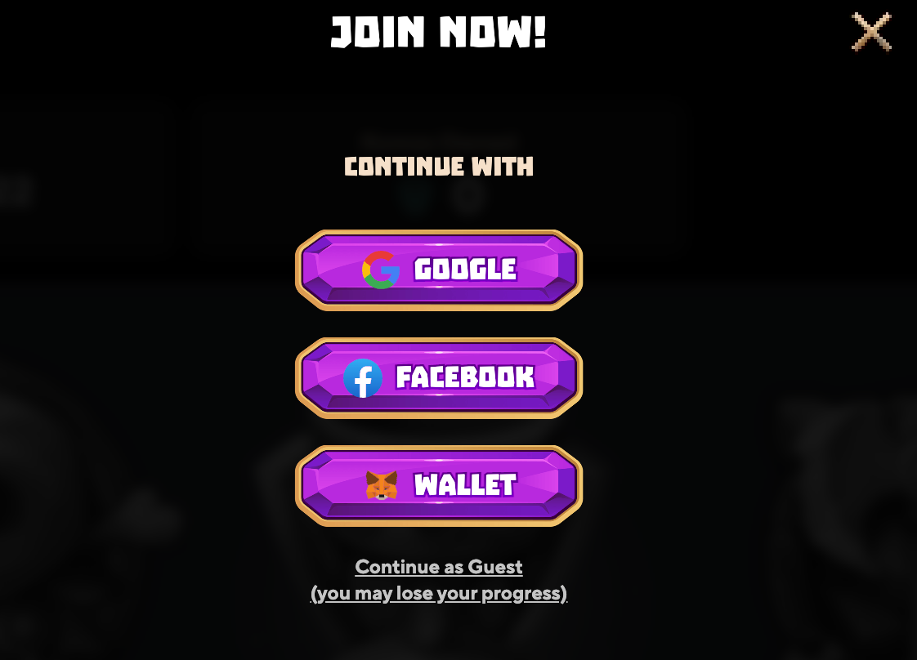
Customer Experience Optimisation
What are some of the challenges of using Ethlas that can be steamed out?
Provide more options, making it easier for users to signup using their preferred mail/wallet services.
Provide an automated email service to both Players and Influencers
This is a series of automated mails sent when influencers/players join, take some actions and a reminder during special events.
A routine and randomised survey can also be conducted which can be sent, after users reach a certain amount of hours played on ethlas, so that we are able to understand issues faced by veteran players and help streamline these issues for a better overall gaming experience.

Slide 15
03
Retention
Making sure users come back to ethlas

Slide 16
FOMO marketing
Changes to the game
Email autoresponder
Small changes that can elevate user experience on ethlas (and the use of a survey to discover current problems) - Discussed in previous slides
Providing opportunities to users to gain more during special time periods
Emails to registered users detailing information on both previous topics

Slide 17
Email Autoresponder
Status Emails
Introductory Emails
New Content Emails
Separate from the ethlas newsletter service, this is a basic marketing automation with less information aimed at engaging users with ethlas and less likely to be a spam *
Emailing regarding events and tournaments; Emails regarding how much Xgems users have made this month/stand to win
Emails regarding new content launches/how to use and other information aiding the user
Emails regarding new content launches

Slide 18
FOMO (Fear of losing out)
marketing
Whiteboard Ideas
A list of cosmetic items which fits the bill of this type of marketing.
In this case certain items can be regularly given to users, which users can only obtain in a certain time period, this can include regular ingame items or unique and new cosmetic items such as a unique emote awarded to users who completed a certain challenge during the event duration.
Information about these time based challenges can be spread in the newsletter or emails to the player, sparking interest and even bring back retention of players who may not be regulars, in fear of losing out an opportunity.
Special emotes as a prize ( can ask for fan submissions for creative inspiration )
A free spin
A free energy
A badge

Slide 19
04
Referral System
How do we get users to further the popularity of ethlas

Slide 20
Methods to encourage users into the referral program without incurring huge additional costs
Email nurture campaign | Cosmetic Items Rewards
An Email nurture campaign to engage and explain the referral program and other opportunities gained by the user referring a friend, Emails can also be used to follow up the status of referrals. | Cosmetic Items, here refers to Any objects items not affiliated with the cryptocurrency. For example: providing a Badge or ‘a free spin’ to players who join refer ethlas to a friend.

Slide 21
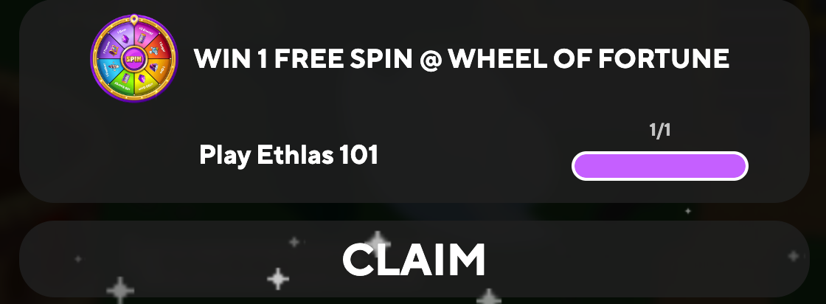
Providing benefits to users for referrals without making loss:
This ‘1 free spin’ opportunity can be provided to the user after a referral, a cheaper alternative to encourage referrals in comparison to xgems. Instead Xgems can be rewarded to users after a certain amount of referrals.

Slide 22
Providing benefits to users for referrals without making loss:
Simple implementations of this method can reduce effort and costs when rewarding players on referral
Awarding the player who refers a friend with a badge as a reward can be achieved in the short run
Unlocking a unique emote after a successful referral
One interesting area of ethlas I discovered can be benefitted was the use of cosmetic goods which do not directly correlate with gems or xgems as to not make a loss

Slide 23
Badge/Emote distribution chart
USER1
User 1 would receive Badge at this stage
USER2
USER3
Both user 2&3 would receive badge and rewards at this point
USER4
USER5
USER6
USER7

Slide 24
End of this presentation

